Slide 1

Analysis of Global Terrorism Database
Sarah Grothus - 12230007​
Aliya Huseynova - 12230214​
Iroda Khamidova - 12194918​
Tural Alizada - 12230118

Slide 2
Table of contents
01
04
Overview of use case
Preparation of data
02
05
Description of data set
Results of analysis
03
06
Analysis process
Conclusion

Slide 3
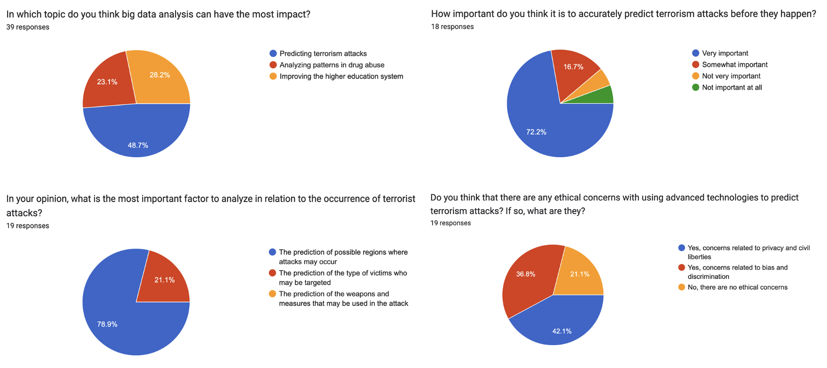
Overview of use case
Focus topics:
1.
Main regions of attack
2.
Correlation attacker and weapon
3.
Correlation between victim and location
4.
Correlation between victim and weapon
Goal: Finding patterns in the Global Terrorism Database
5.
Correlation between location and attacker
Knowing patterns can help increase security measures that can prevent the loss of life

Slide 4
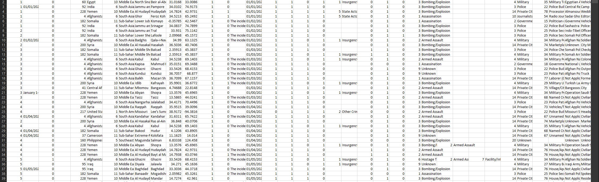
Description of data set
The Global Terrorism Database is an open-source database, which consists of the information about the terrorist attacks from 1970 to June 2021. There are two Excel files in the set: one from 1970 to 2020, and the second from January 2021 to June 2021. The data includes domestic, transnational, and international terrorist attacks containing more than 200.000 cases in total.

Slide 5
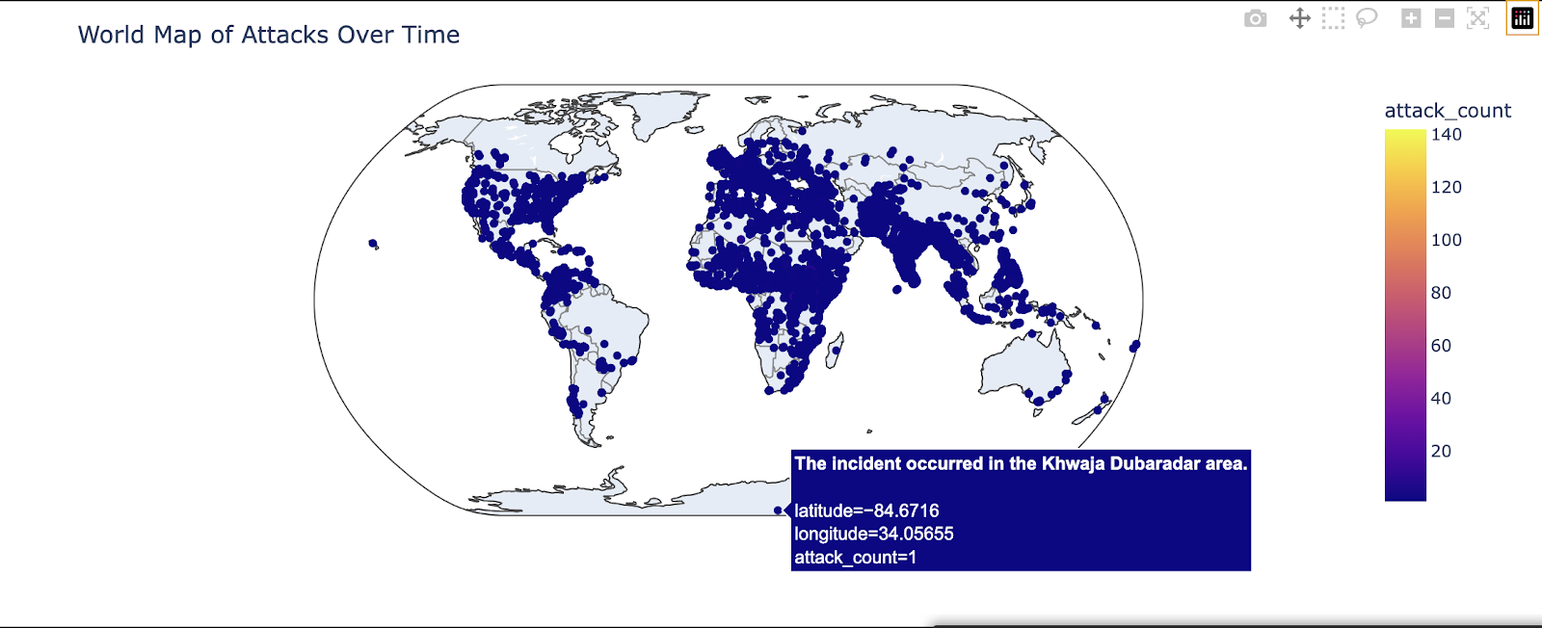
Analysis process
To make the analysis simpler: deleted all the columns that are not necessary for our analysis.
To analyze the data: used Python (Jupyter Notebook), the IDE Visual Studio Code as well as ChatGPT for guidance.
Which data analyzed:
Main regions of terrorist attacks (Sarah)
Correlation of location of attack and weapon used (Tural)
Correlation of location of attack and type of victim attacked (Tural)
Correlation of type of victim and weapon used (Aliya)
Correlation of location of attack and terrorist (group) (Aliya)
Correlation of terrorist (group) and type of weapon used (Sarah)

Slide 6
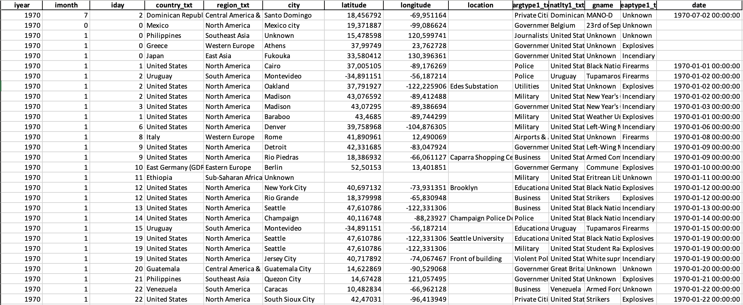
Preparation of data
Status before cleaning:
Data was already curated
Handle missing values during analysis depending on case
2 excel files
A lot of features
Cleaning:
Tool: Python
Merging excel files
Reduction of features
Adding datetime column
Reduction from 142 to the 14 most important features

Slide 7
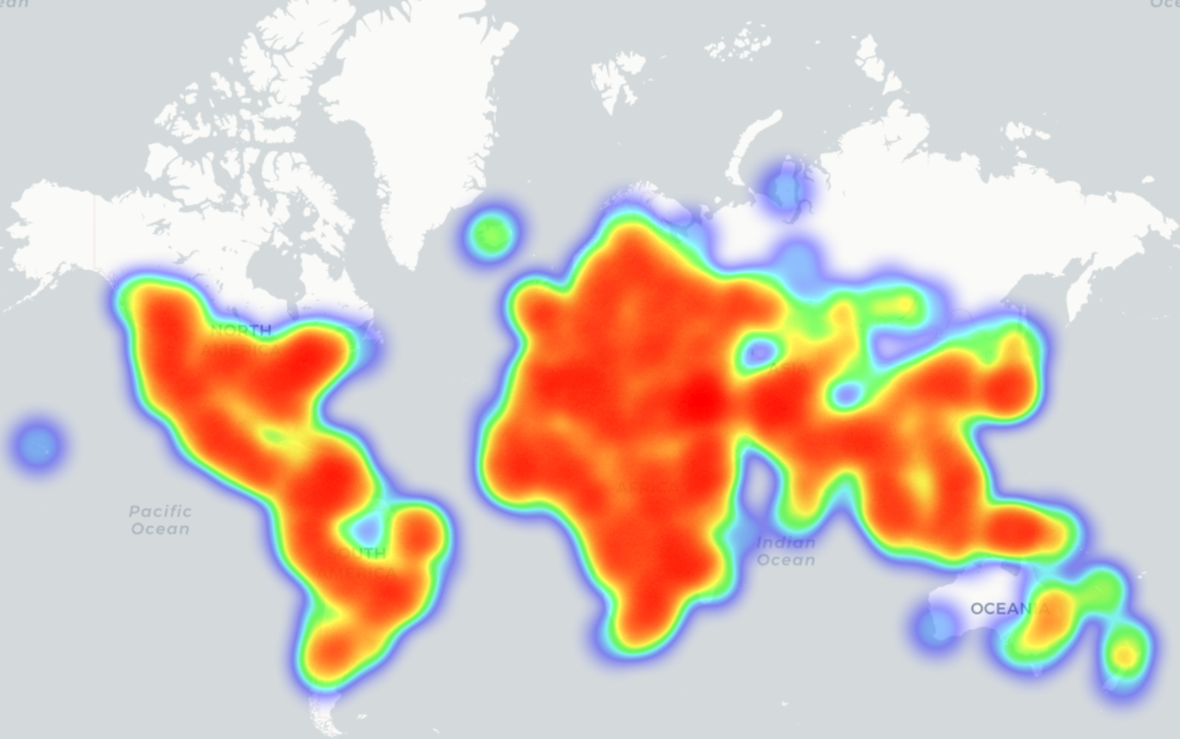
Main regions of attack
Top 5 countries with the most attacks in the last 15 years:
1.
Iraq
24,964
2.
Afghanistan
19,215
3.
Pakistan
13,092
4.
India
9,757
5.
Yemen
6,160
Interactive heat map showing attacks from last 15 years

Slide 8
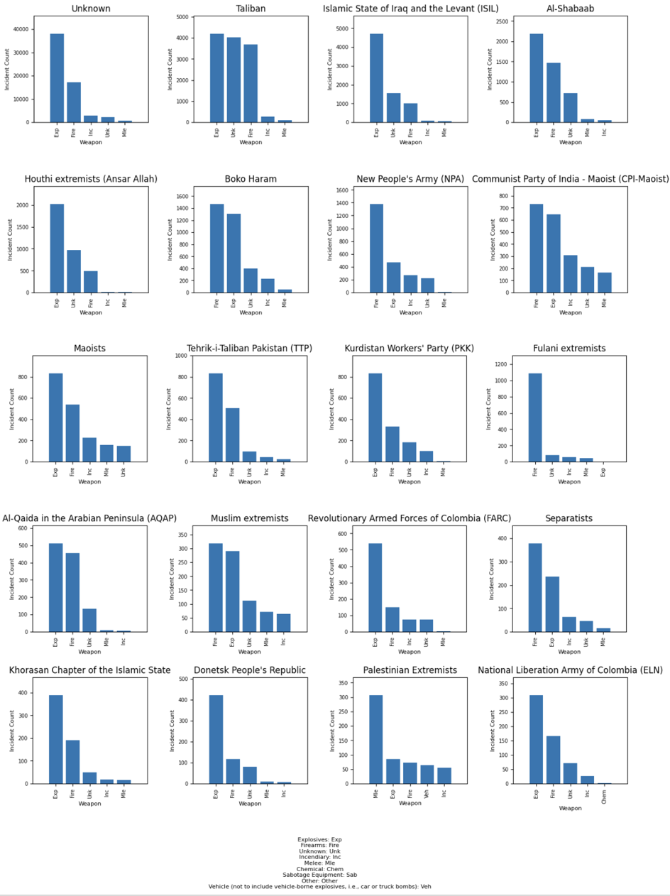
Correlation between terrorist group and weapon
Top 5 weapons used by most active terrorist groups in last 15 years:
Summary of insights:
Correlation between weapon and terrorist group is rather low
Regarding the most active terrorist groups, mostly explosives, firearms or unknown weapons are used

Slide 9
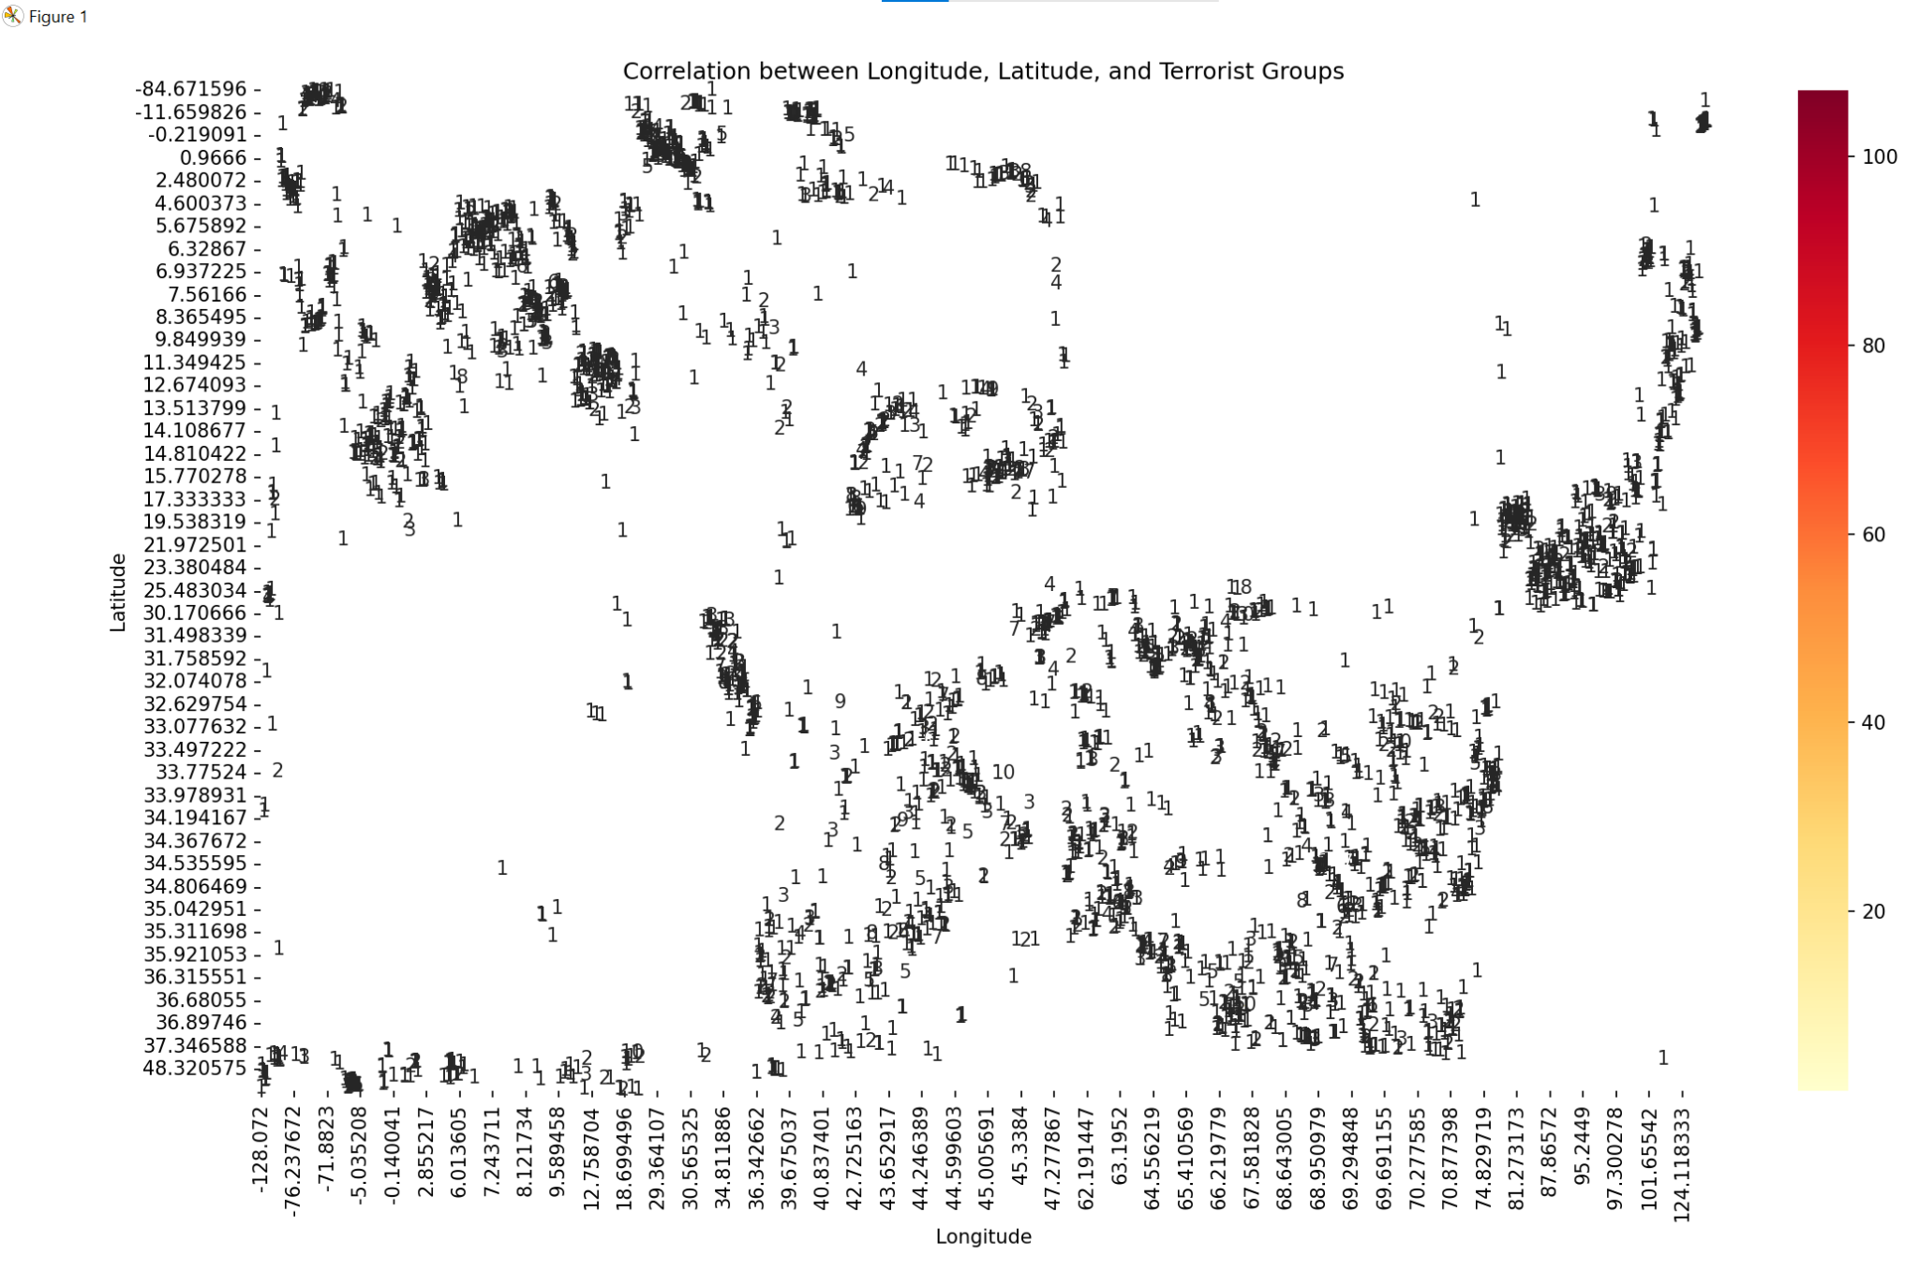
Correlation of location of attack and weapon used
Inspecting this graph, certain conclusions can be made based on the geographical concentration of terrorist attacks and Identification of high-risk regions.

Slide 10
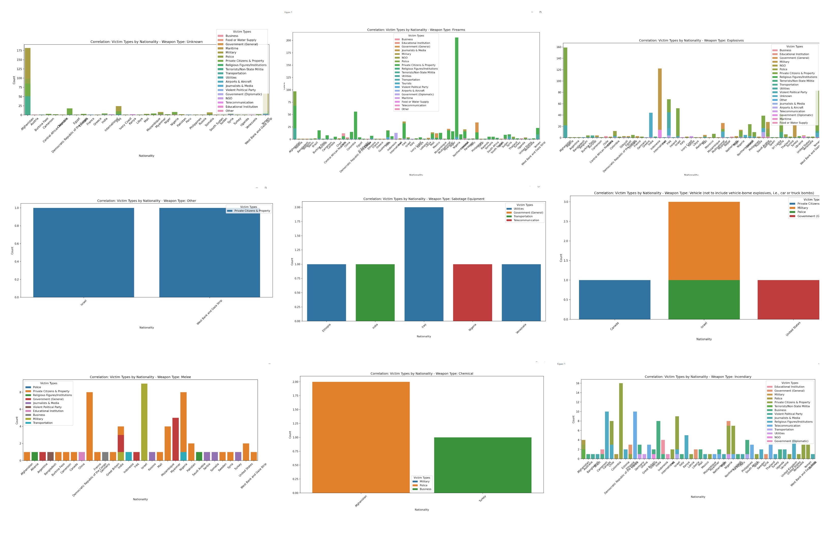
Correlation of location of attack and type of victim attacked
Using gathered information, certain observations based on nationality & occupation of a victim have been made; for example, explosive weapons are mostly being used in Afghanistan towards private citizens.

Slide 11
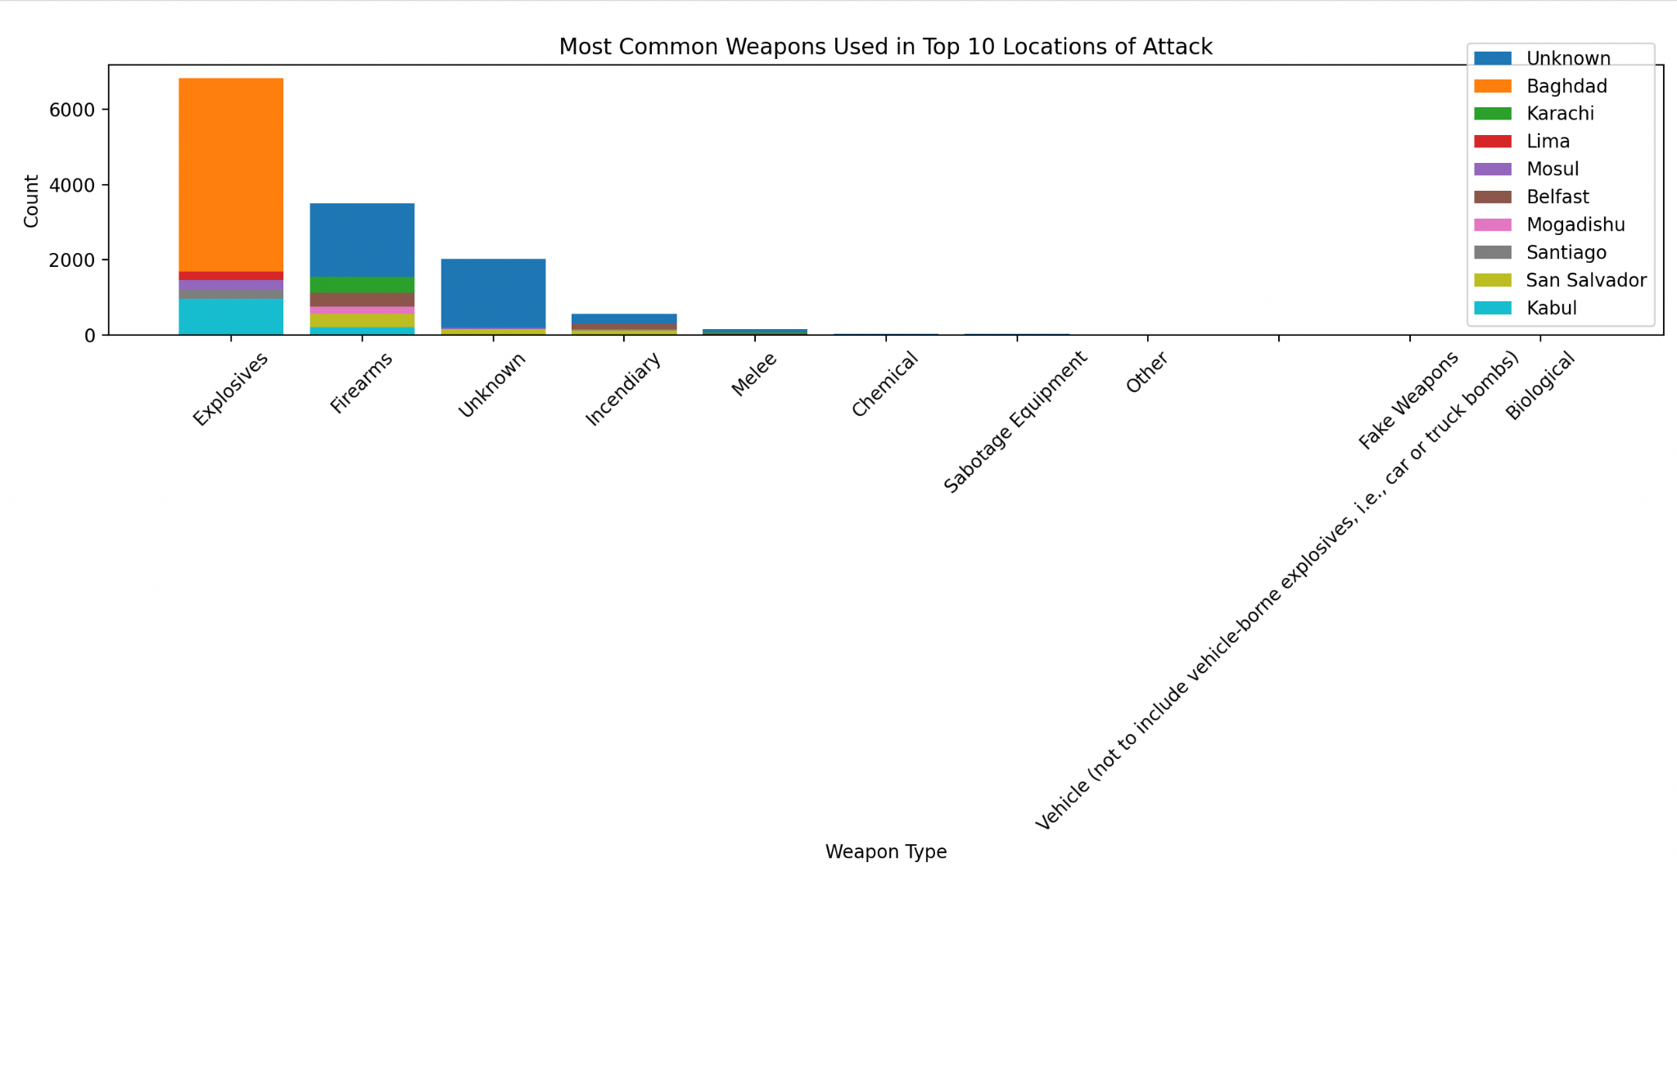
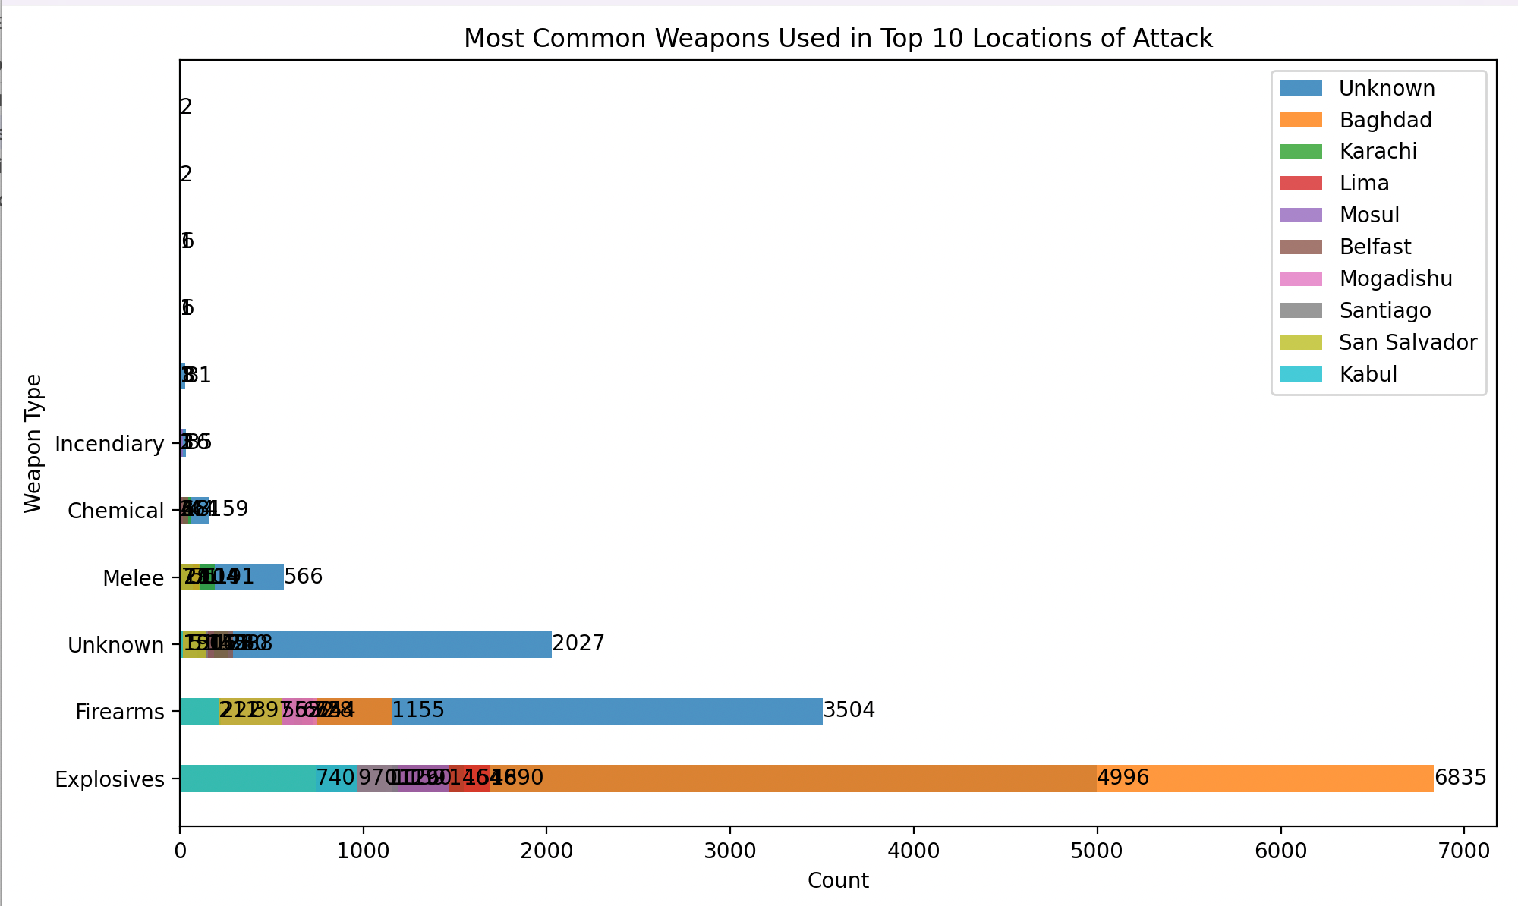
Correlation of location of attack and weapon used
As shown in these graphs, Baghdad is the most common area of terrorism attacks and explosives weapons used the most

Slide 12
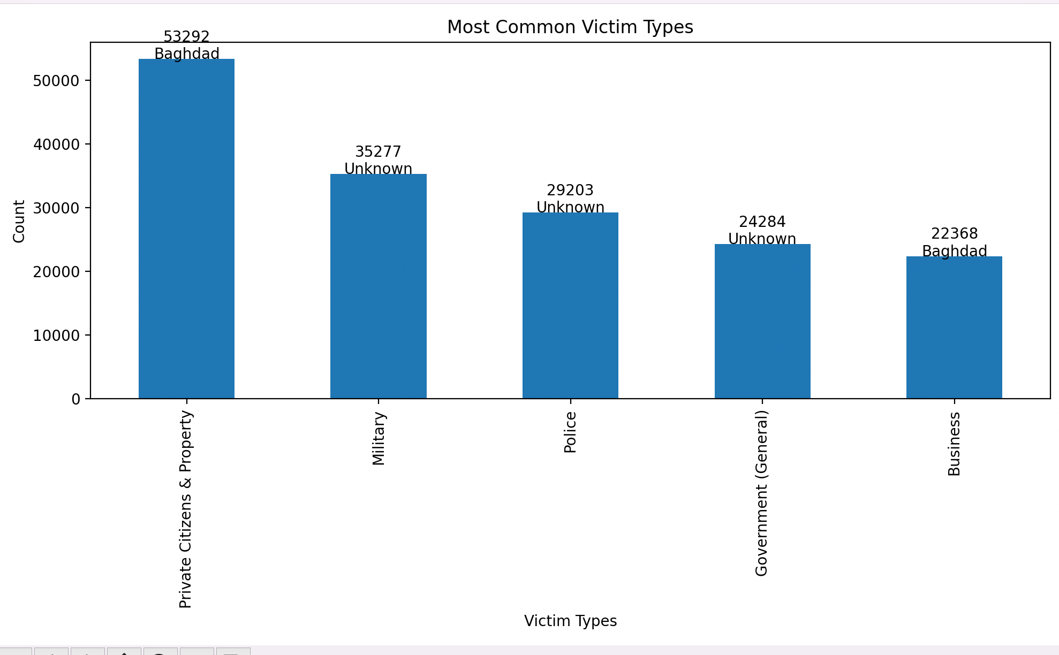
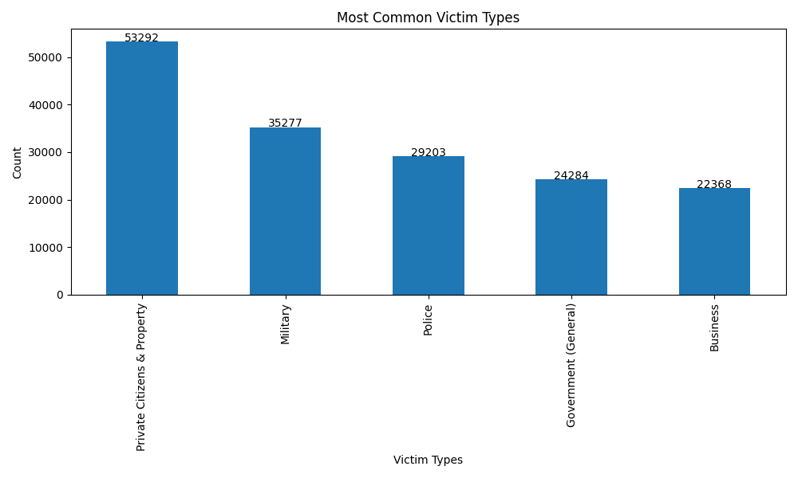
Correlation of location of attack and type of victim attacked
The graphs shows that:
The most common area -> Baghdad, as shown in the previous analysis
The most common type of victim attacked in these area -> Private Citizens & Property

Slide 13
Conclusion
Improved investigation of global terrorism dynamics
Insights into the correlation between different attributes
Additional security measures
Enhanced decision-making for counterterrorism policies and strategies.

